Slide 1
Logistic Regression

Slide 2
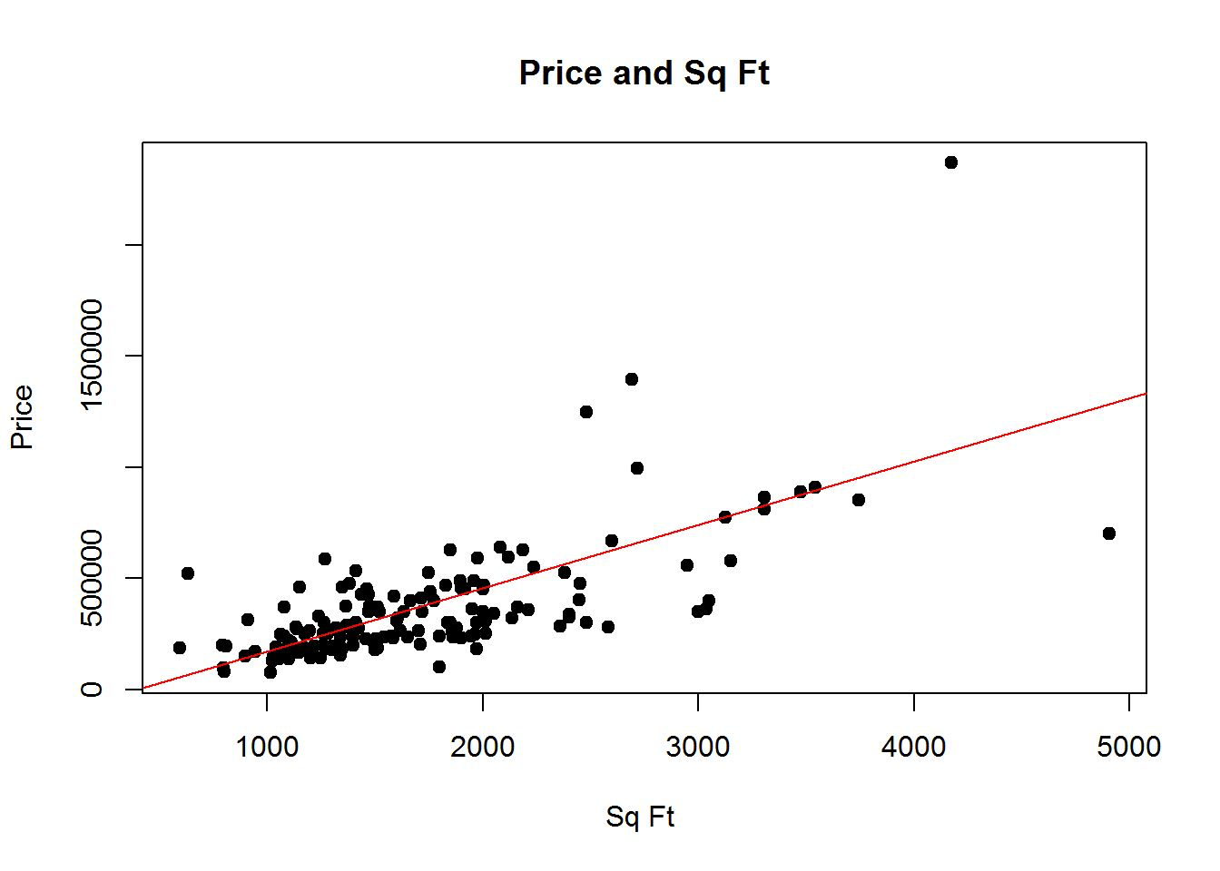
Previously
House pricing
Continuous label

Slide 3
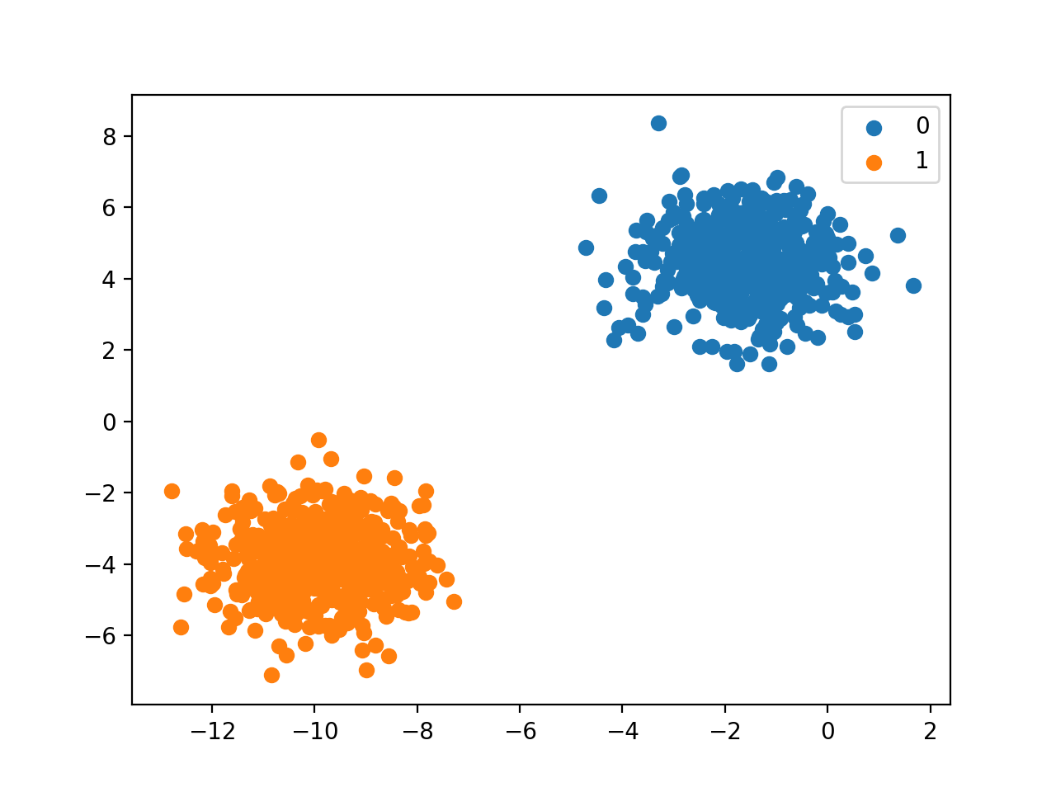
What if the label is not continuous?
Do you belong to class 0 or class 1?
Do you have a disease (1) or not (0)?
Categorical label
Predicting categories - classification

Slide 4
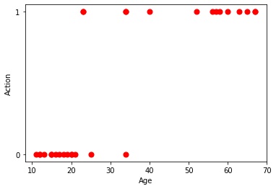
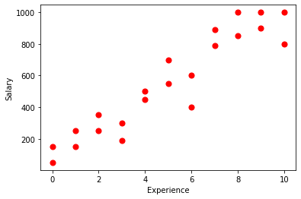
New Familiar
???

Slide 5
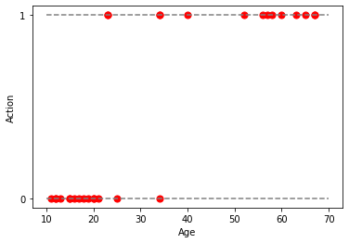

Slide 7
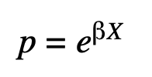
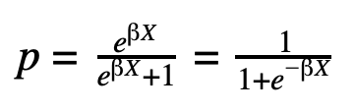
The actual scientific approach
Two steps:
It must always be positive (since p>=0)
It must always be less than 1 (since p<=1)

Slide 8
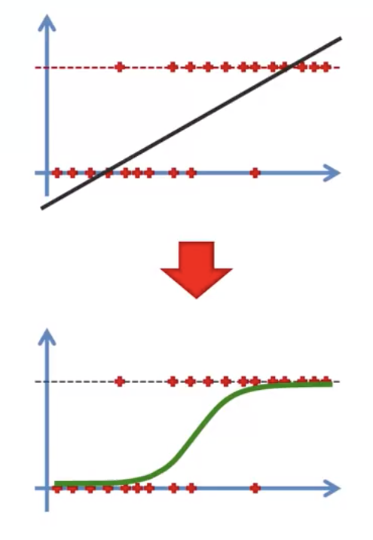
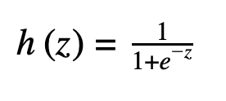
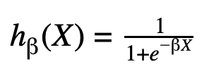
Sigmoid function:
Logistic function:

Slide 9
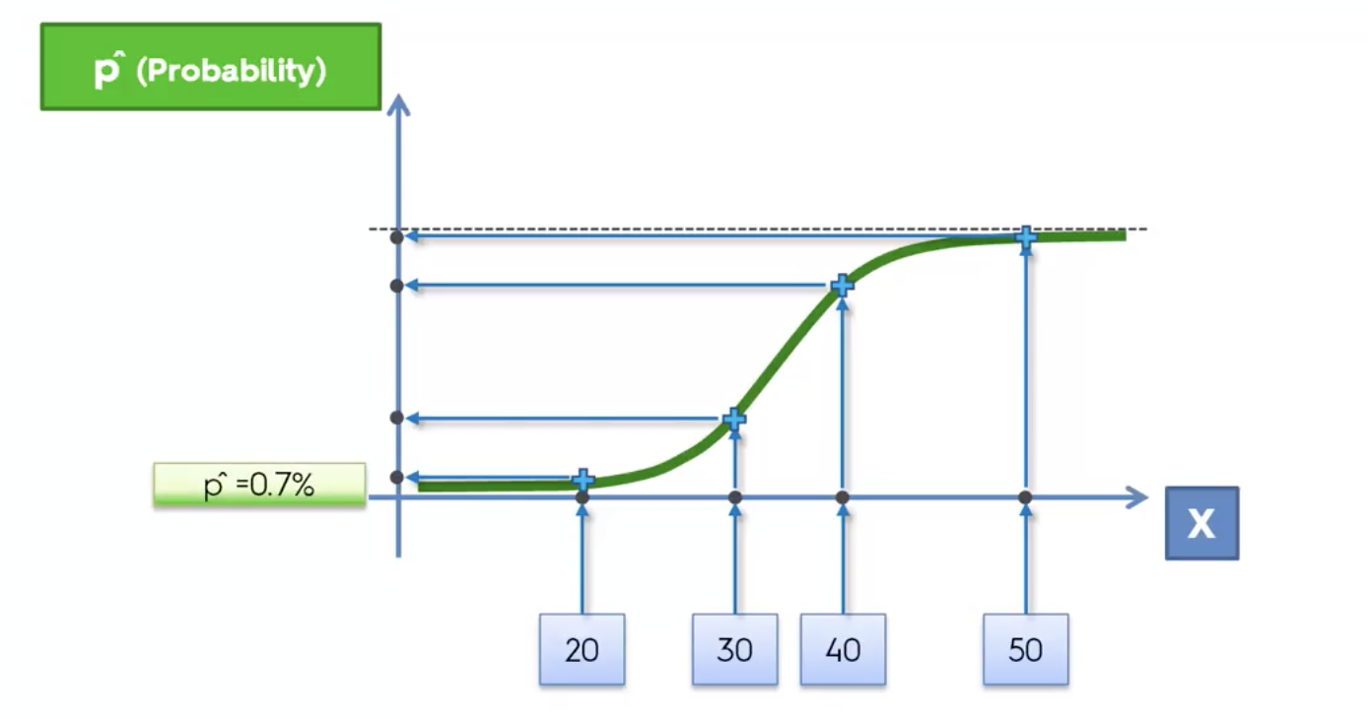

Slide 10
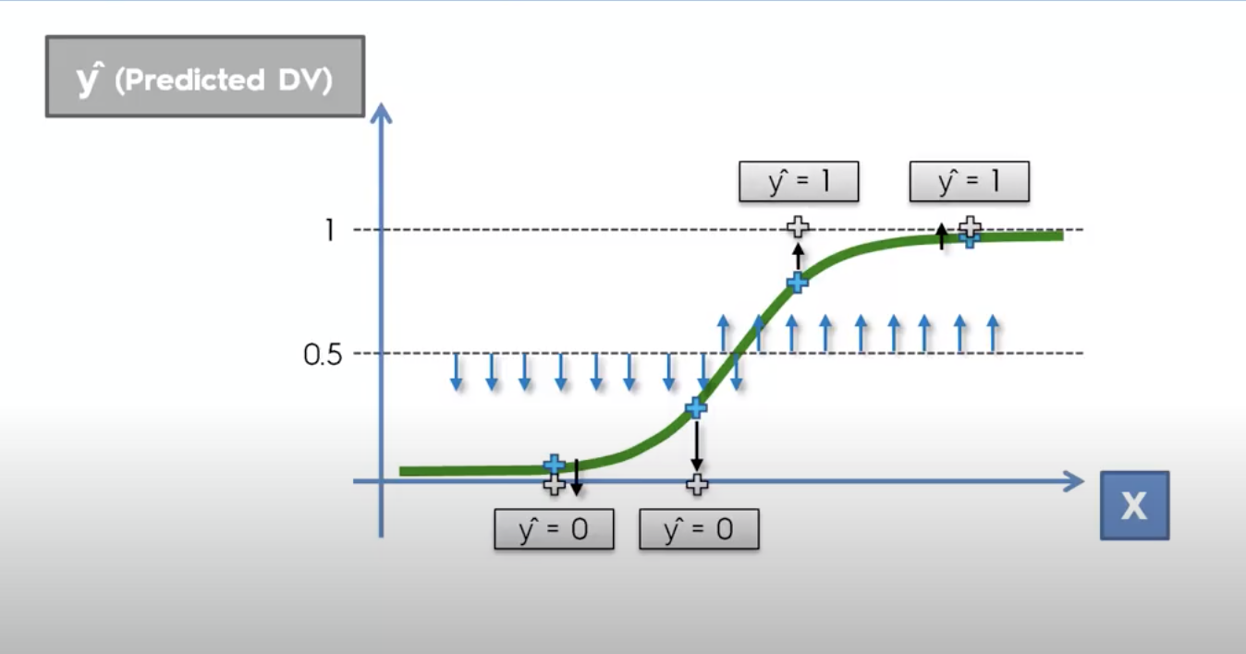

Slide 11
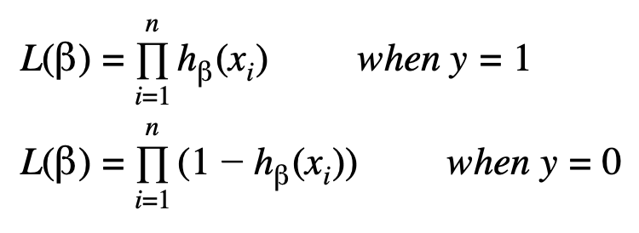
How to estimate the coefficients beta?
Maximize the Likelihood function

Slide 12
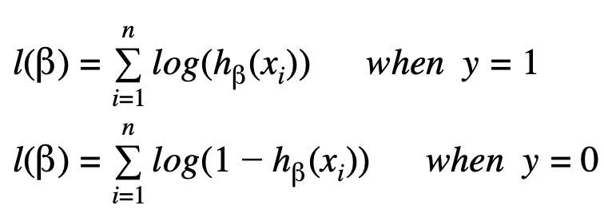
How to estimate the coefficients beta?
Maximize the log Likelihood function

Slide 13
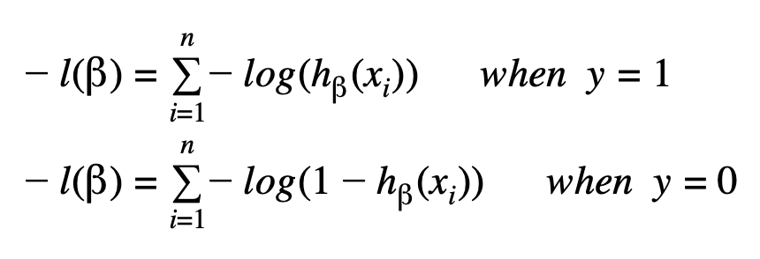
How to estimate the coefficients beta?
Minimize the negative of log Likelihood function

Slide 14
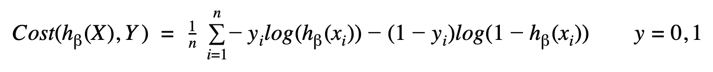
How to estimate the coefficients beta?
In matrix form and adding the term 1/n:

Slide 15
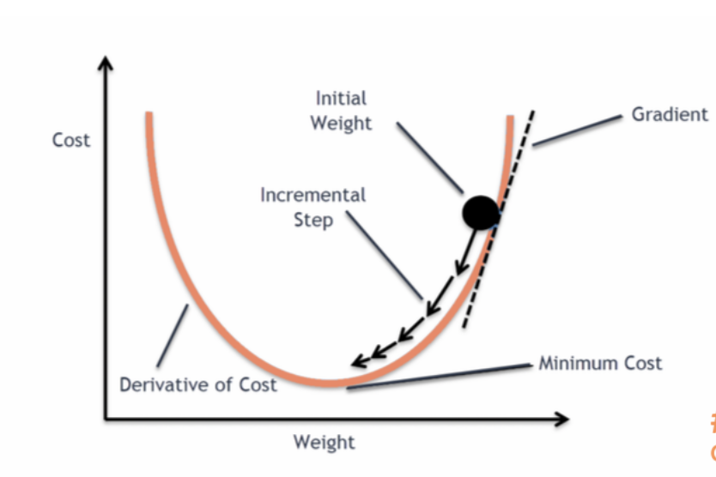
Gradient Descent
Gradient - vector of partial derivatives
The direction of fastest growth of the function
We need to minimize = > will follow the opposite direction of the gradient

Slide 16
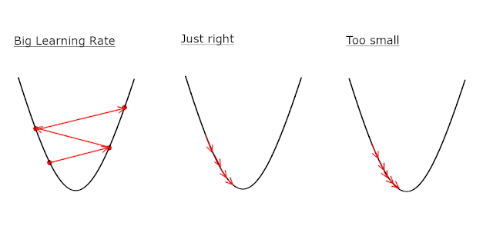
Learning Rate

Slide 17
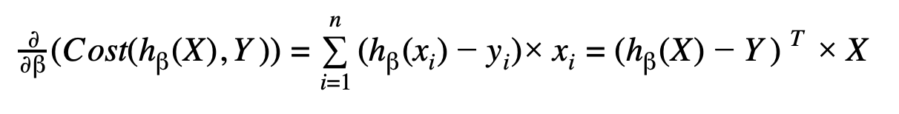
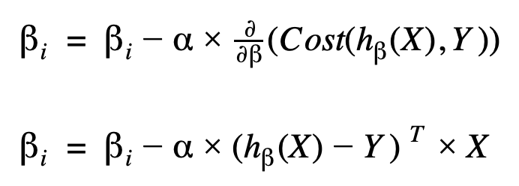
Gradient descent
Initialize vector beta (say with zeros)
Choose a step
Choose a # of iterations and/or choose threshold for a change in cost function value

Slide 18
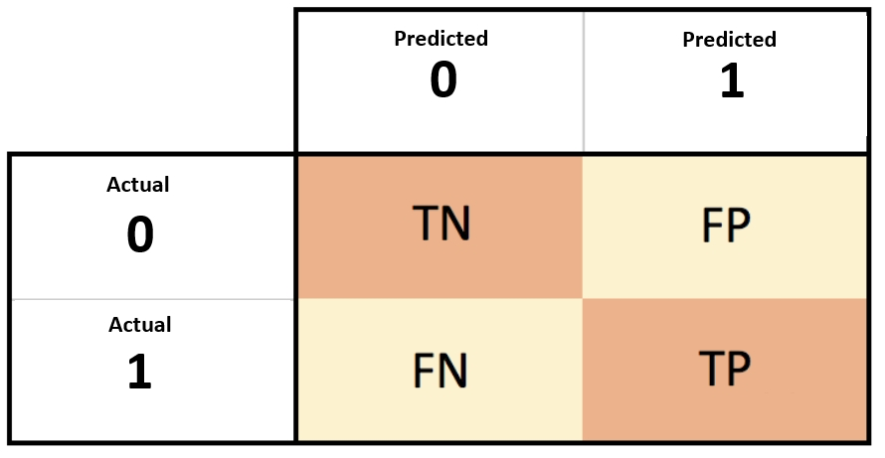
Model Evaluation
Confusion matrix

Slide 19
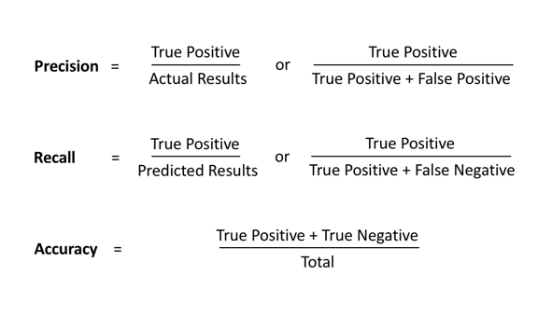

Slide 20
When to use the metrics?
Does the patient have cancer? -> cost of false negatives is high
Use Recall
Is this wine good or not? -> cost of false positives is high
Use Precision

Slide 21
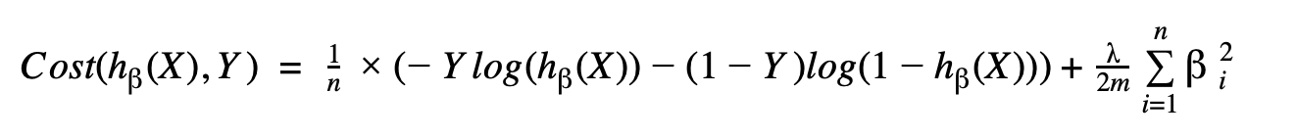
Regularization
L2 regularization
Penalizing high coefficients
Avoid overfitting

Slide 22
Thank you!

